Slide 1
Data Analyst Practical Exam
Pens and Papers Sales Analysis
Written By: Uzma Ahmad
Date: 4th February 2025

Slide 2
Business Overview & Objective
Company Overview:
Pens and Printers was founded in 1984 and provides high-quality office products to large organizations.
The company sells a variety of office supplies, from pens and notebooks to desk chairs and monitors.
Pens and Printers does not manufacture its own products but sells those made by other companies.
New Product Launch & Sales Strategies:
Six weeks ago, Pens and Printers launched a new line of office stationery.
Three sales approaches were used:
Email Only: Customers received an initial product launch email and a follow-up three weeks later.
Call Only: Sales team members called customers directly, averaging 30 minutes per call.
Email + Call: Customers received an initial email, followed by a call a week later, averaging 10 minutes per call.
Objective:
Ensure efficient sales techniques for new product launches to maximize revenue and minimize costs.

Slide 3
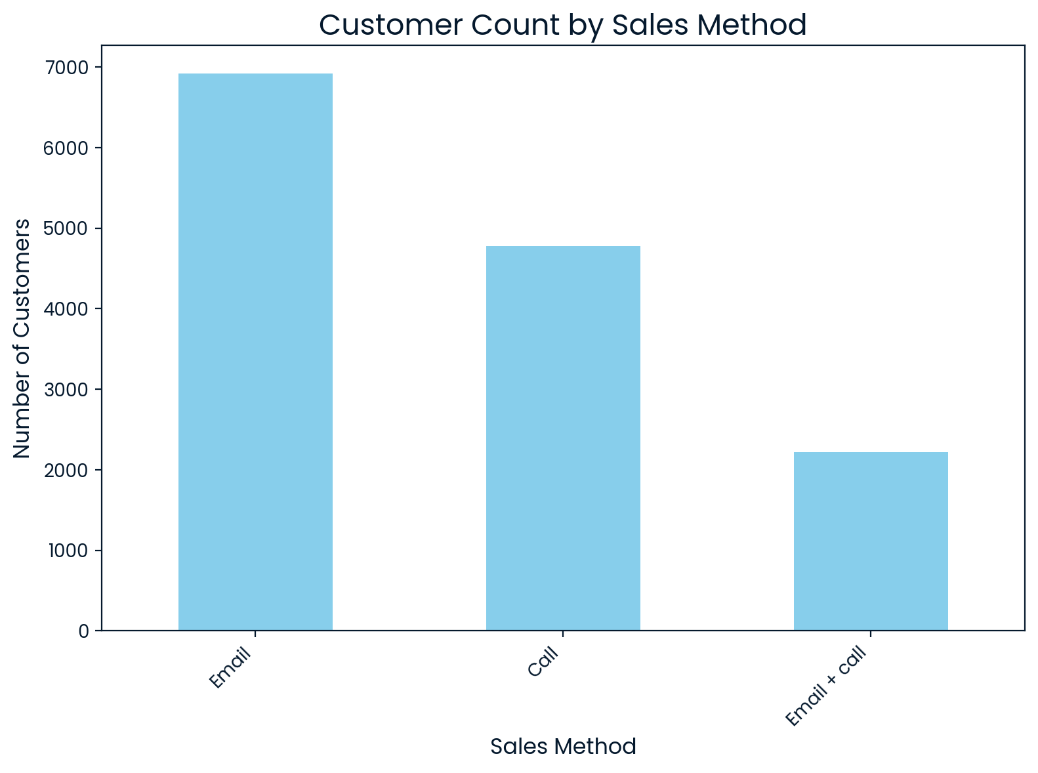
Customer Engagement How many customers were there for each approach?
The Email approach reached the highest number of customers, totaling 6,921.
The Call method followed with 4,780 customers.
The Email + Call strategy had the lowest reach, with 2,223 customers.

Slide 4
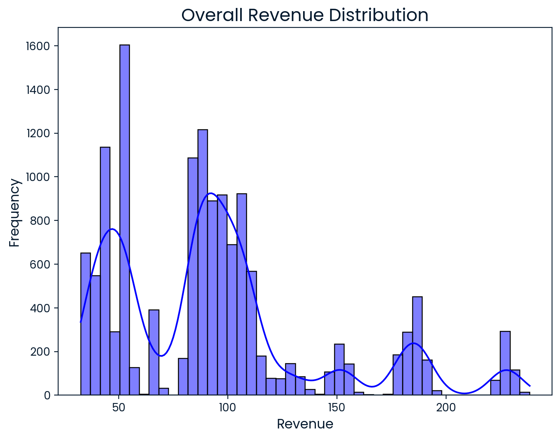
Revenue Analysis What does the spread of revenue look like overall?
The histogram reveals a multi-modal distribution, indicating revenue isn't concentrated around a single value.
Peaks at $50 and $90 represent key revenue-generating price points.
Avoid prices around $70 and above $120 as they show lower sales activity.
Focusing on the peaks can help optimize pricing strategies and drive higher sales.

Slide 5
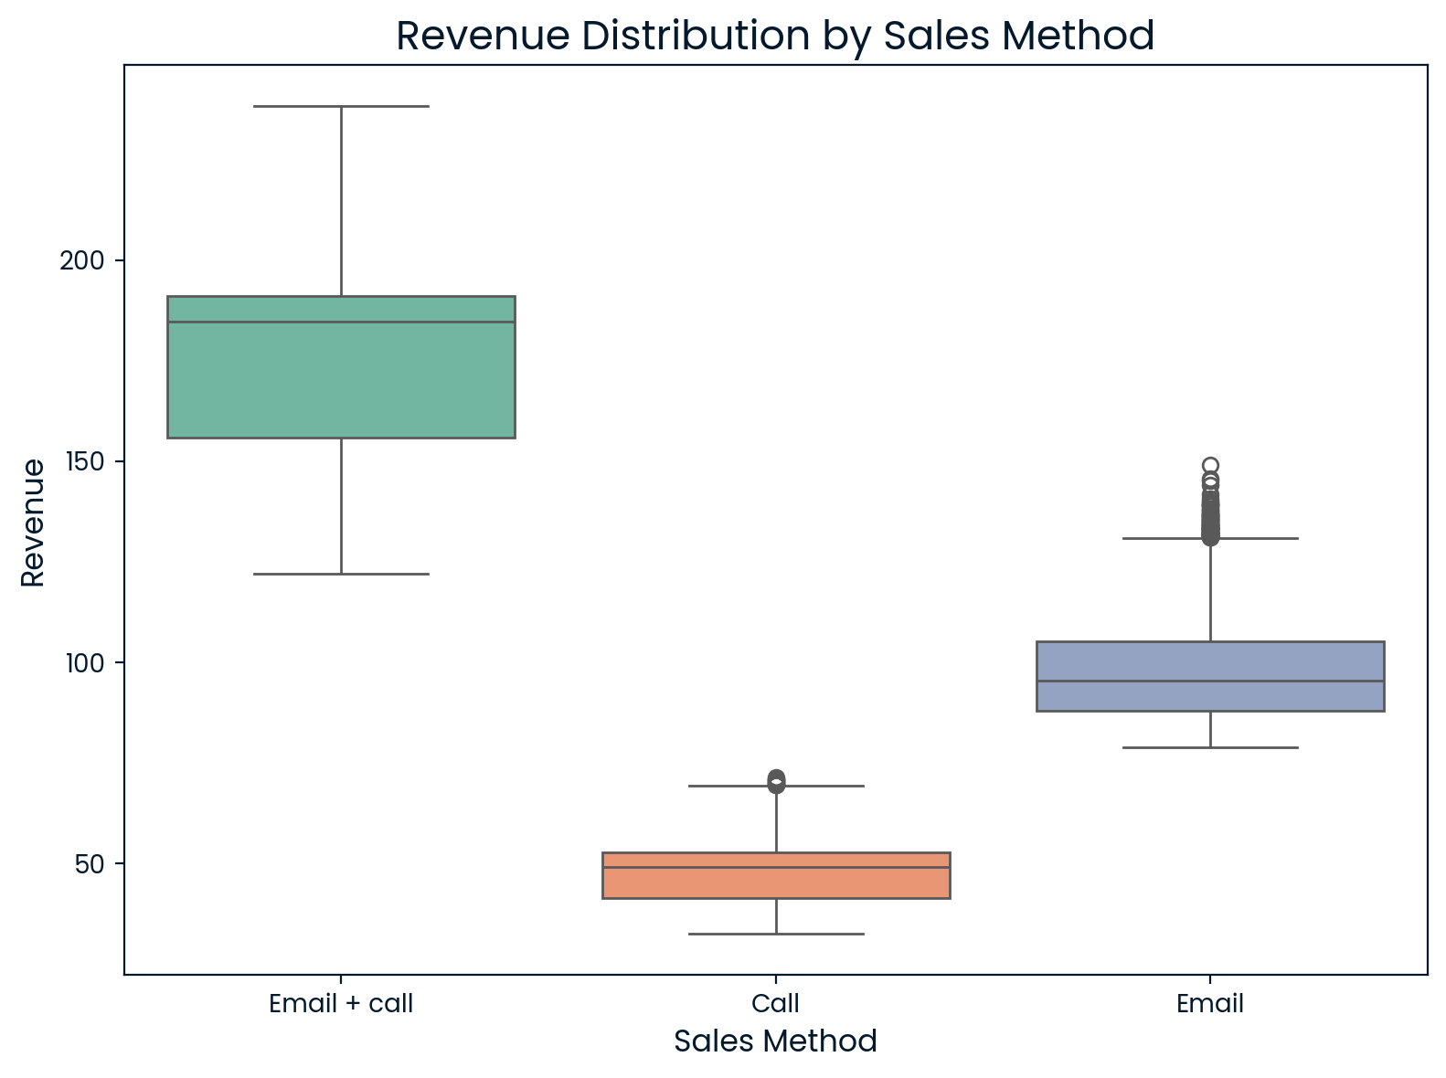
Revenue Analysis What does the spread of revenue look like for each sales method?
Email+ call method: Results in the highest revenue.
Email method: Sales are primarily clustered below $100 and just over $100, with a few outliers around $150 which represent successful marketing campaigns or promotions that encouraged customers to make higher-value purchases.
Call method: Revenue is mostly concentrated around $50, with a few outliers above this level probably due to successful negotiations or deeper customer engagement.

Slide 6
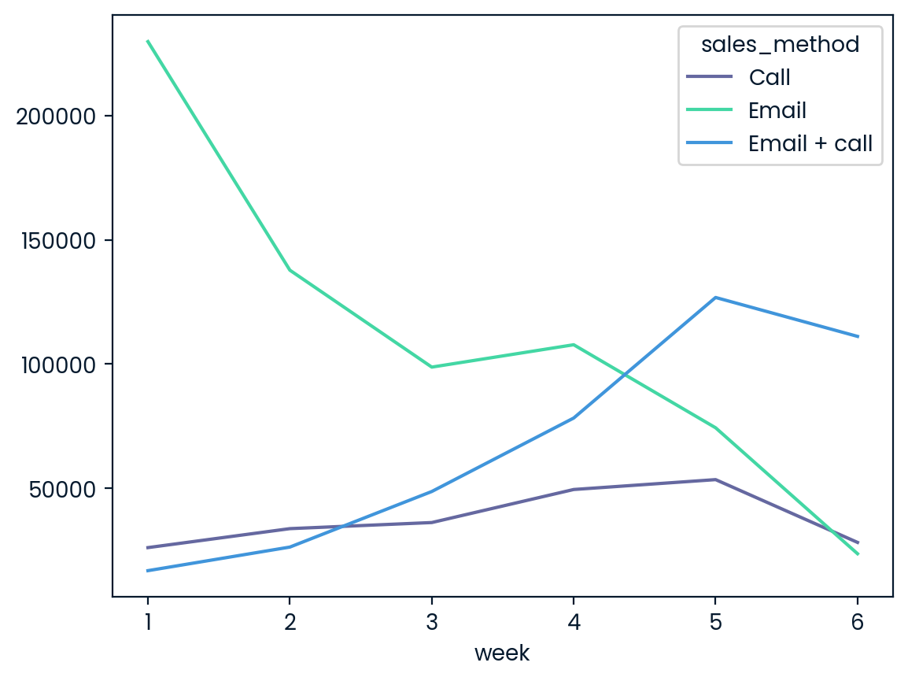
Revenue Analysis Was there any difference in revenue over time for each of the methods?
Email + call method: Began at $16,885.33 in Week 1 but showed consistent growth each week. By Week 6, it reached $111,152.07, becoming the most successful method.
Email method: Started strong in Week 1 with $229,765.55 but dropped significantly in the following weeks. By Week 6, revenue declined to $98,792.14, showing over a 58% decrease.
Call method: Started at $26,159.18 in Week 1, with a steady increase in revenue. By Week 6, revenue was moderate at $28,252.92, remaining lower than both the Email and Email + Call methods.

Slide 7
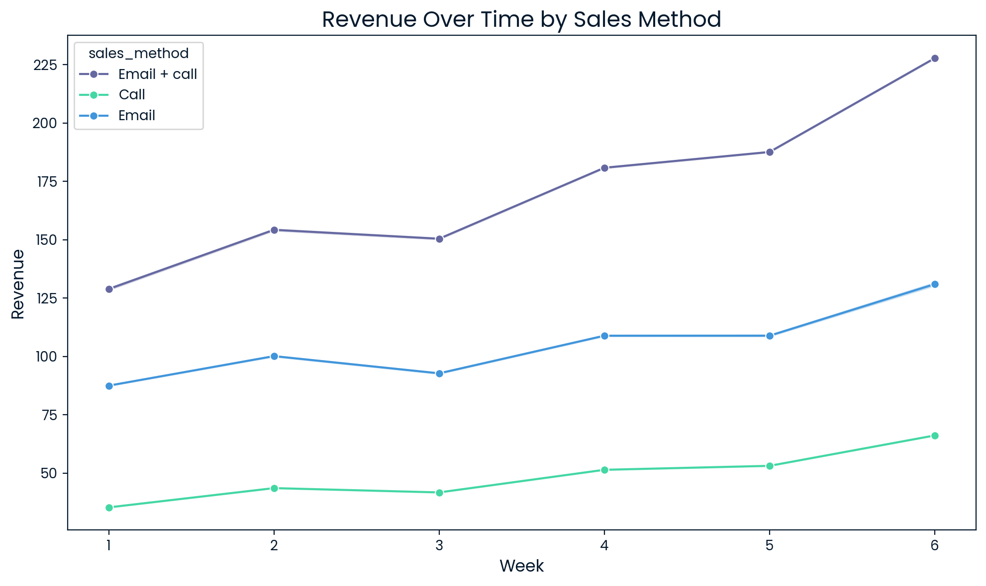
Based on the data, which method would you recommend we continue to use?
Email + Call method would be the best choice.
This method not only starts with the highest mean revenue but also maintains consistent growth throughout the weeks. By the end of the period, it consistently produces the highest average revenue compared to the other methods.
Email method although it starts strong, its significant decline over time means it is less reliable for consistent long-term revenue generation.
Call method generates the lowest mean revenue overall, despite showing steady growth. It remains less effective compared to the other two methods.
Thus, Email + Call is the most reliable and successful method for maximizing revenue.

Slide 8
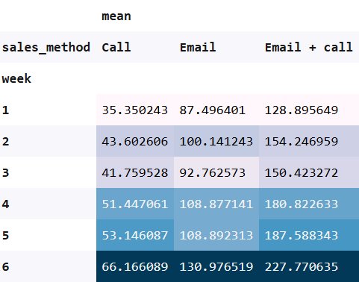
Business Metric to Focus On: Average Weekly Revenue per Sales Method
The key business metric to focus on is Average Weekly Revenue per Sales Method, which measures the effectiveness of each approach (Call, Email, and Email + Call) in generating revenue weekly.
By tracking this metric, the business can assess which method drives the most revenue, allocate resources effectively, and adjust strategies accordingly.
By analyzing the table we can see that Email + call method has shown the highest revenue growth and is the most efficient, while Email and Call methods have shown steady but lower performance.
Based on the data, prioritizing Email + Call will maximize revenue and improve overall sales performance.
Estimated Initial Values (Average Weekly Revenue over 6 Weeks):
Call Method: $48.74
Email Method: $101.87
Email + Call Method: $163.79

Slide 9
Summary & Recommendations
The report evaluates the three sales method: Call, Email, and Email + Call, by analyzing their Average Weekly Revenue per Sales Method.
The Email + Call method outperforms the others in both revenue generation and efficiency, requiring only 10 minutes per call. It is recommended to prioritize and scale this method by training the sales team, using automated email tools, and personalizing content for better customer engagement.
The Email method shows steady growth with low effort and should be enhanced by segmenting the audience and refining email messaging.
The Call-only method, while still contributing to revenue, is less efficient and more time-consuming, requiring 30 minutes per call. Resources should be shifted away from this method, focusing more on Email + Call to maximize impact.
Regular tracking of weekly revenue is crucial for adjusting strategies, while benchmarking against industry standards can help identify areas for improvement.
Overall, focusing on Email + Call will maximize revenue and improve sales performance.

Slide 10
Thank you

